Slide 1




SEGMENTATION USING CUSTOMER LIFETIME VALUE HYBRID K-MEANS AND ANALYTIC HIERARCHY PROCESS
Thesis Defence – Master of Science Management
Radit Rahmadhan
29020003
Supervisor : Meditya Wasesa, Ph.D.
Examiners : 1. Dr. Manahan Siallagan 2. Prawira Fajarinda Belgiawan, Ph.D.
Bandung, 22 December 2022

Slide 2


The
The Outline of Presentation
01 | INTRODUCTION
Background and Problem Statement
Research Question and Research Objectives
Research Method
Research Scope
Customer Segmentation Based On Electricity Consumption Data
Customer Segmentation Based On Customer Lifetime Value
Marketing Strategy in Customer Relationship Management
Research Position
02 | LITERATURE REVIEW
Research Philosophical Position
Research Framework
Data Collection
Data Cleaning, Choice Of Variable
Clustering Model
Marketing Strategy Definition
03 | METHODOLOGY
Results of Clustering
Results of Customer Lifetime Value
Implementation of Customer Relationship Management
04 | RESULT AND ANALYSIS
05 | CONCLUSION
General Conclusion
Research and Practical Implications
Limitation and Further Research

Slide 3

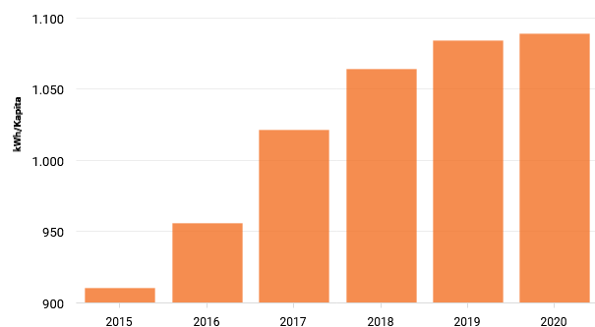

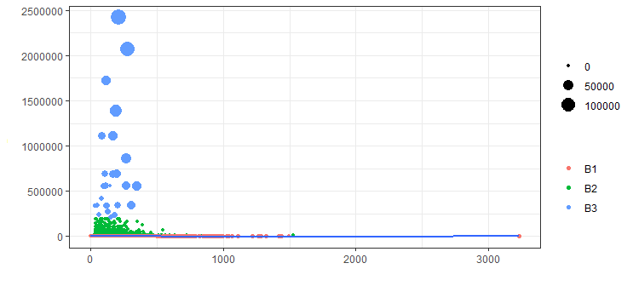
Background and Problem Statement
Source: Katadata.co.id
Business Customer
Source : Interview Results from several PLN customers in the West Sumatra Zone
Electricity consumption in Indonesia increased by 98.89%
Electricity blackouts occur up to four times a month.
Source : PLN customer transaction data for West Sumatra Region from 2019 to 2020
Source : PLN customer transaction data for West Sumatra Region from 2019 to 2020
Low consumption of business customers due to power outages (below 50 hours per month)
Customers using more than 200k of power during peak load than off-peak electricity while during non-peak load hours, usage is low.
01 | INTRODUCTION

Slide 4




Research Questions and Research Objective
RQ1
“How to develop an accurate customer segmentation model according to the characteristics of electricity customers using West Sumatra Zone business customer transaction data? “
Objectives :
To develop a hybrid model of customer segmentation to find the right grouping of electricity customers according to their consumption patterns.
RQ2
“How to implement marketing strategies according to customer criteria based on the results of the customer segmentation model?
Objectives :
To apply the concept of Customer Relationship Management (CRM) Strategy according to the characteristics of its customers in order to meet the demand for electricity effectively.
01 | INTRODUCTION

Slide 5
Research Method and Research Scope
Research Method
Research Scope
This research adopted and modified the predictive analytics framework by (Shmueli & Koppius, 2011) to develop a hybrid segmentation model
01
This study focuses on the electricity consumption of business customers specific to the Padang region
02
This study used one month of business customer transaction data
1
2
Data Collection
Data Preparation
03
This study examines proposed using a combination of machine learning models namely K-Means Clustering, Customer Lifetime Value and Customer Relationship Management (CRM) strategies
5
4
3
Model Use & Reporting
Model Evaluation
Model Development
01 | INTRODUCTION

Slide 6
Customer Segmentation Based on Electricity Consumption Data
Article | Business Context | Dataset | Segmentation Features | Segmentation Method
(McLoughlin et al., 2015) | Electricity Load Profile in Ireland | Experimental data period January 1, 2009, to December 31, 2010, | Dwelling type, No. of bedrooms, Age, Social Class, Electronic Type | K-means, k-medoid and Self Organizing Maps (SOM)
(Jang et al., 2021) | Electricity Load Profile | Smart Metering Data in 2009 | Identity, Social Status, age, gender, Demand kWh, Income | Regression Ordinary Least Square (OLS), Evaluation (Root Mean Square Error (RMSE))
(E. Lee et al., 2020) | Electricity Load Profile | Residential Demand Data during November,2017 until Febuary, 2018 | Identity, Daily Consumption, Load Profile, Peak Hour, Demand | K-means, Fuzzy C-Means (FCM) and Self Organizing Maps (SOM)
(Afthoni et al., n.d.) | Electricity Consumption in Indonesia | Customer Transaction in September 2021 | Rate, Power, Total kWh, Total Cost, Flash Time | Model (K-Means),Validity (Silhouette Method) combines (Customer Relationship Management (CRM))
02 | LITERATURE REVIEW

Slide 7
Customer Segmentation Based on Customer Lifetime Value
Study | Business Context | Dataset | Segmentation Features | Segmentation Model
02 | LITERATURE REVIEW

Slide 8
Marketing Strategy in Customer Relationship Management
02 | LITERATURE REVIEW

Slide 9
Research Positioning
02 | LITERATURE REVIEW

Slide 10
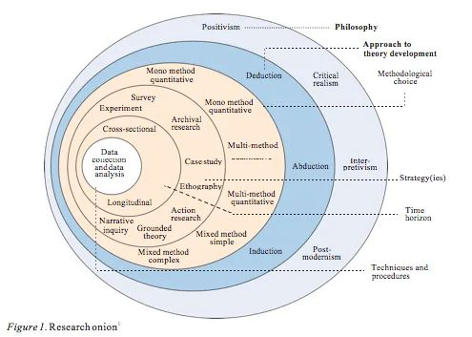
Research Philosophical Position
Pragmatism
Deduction
Quantitative Method
Case Study
Longitudinal
Quantitative Data Collection
03 | Methodology

Slide 11
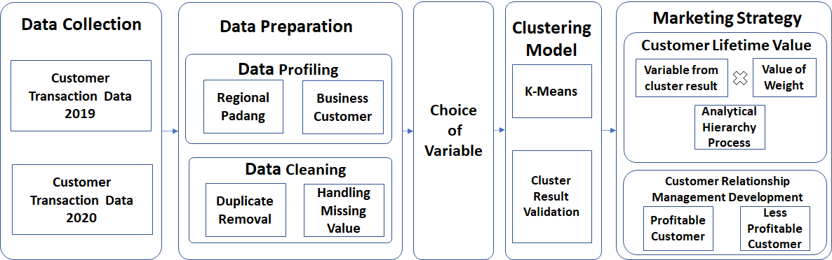
Research Framework
03 | Methodology

Slide 12


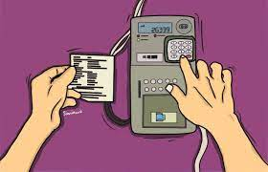

Data Collection
PT.PLN Persero West Sumatera Region Data
Data | Year | Row | Variable | Data Used
Customer Transactions history | 2019 | 7,945,689 | 107 | July,2020
Customer Transactions history | 2020 | 8,558,539 | 107
Total Data |  | 16,504,228 |  | 1,835,212
03 | Methodology

Slide 13
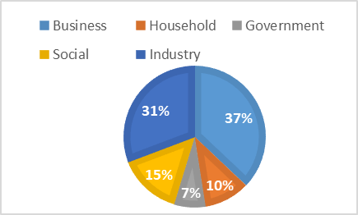
Data Preparation
Data Profiling
Regional
Customer
Padang area has the highest electricity consumption compared to other locations.
Focuses on business customers
03 | Methodology

Slide 14

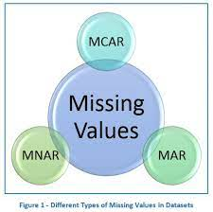
Data Preparation
Data Cleaning
Data Cleaning Description
Variable | Data Type | Count | Max | Min | Variable Description
ID Customer | Integer | 24,785 | - | - | Identity of the customer
Customer Service Unit | String | 12 | - | - | Customer Service Units or service branches provided by the company which are in 4 customer service centers namely Belanti, Painan, Indarung, Pariaman, Lubuk Basung, Lubuk Sikaping, Koto tuo, Baso, Sijunjung, Sungai Rumbai, Kayu Aro, Sawah Lunto, Batusangkar, Lintau, Lima Puluh Kota and others
Data Entry Date | Date | 24 | 2020/12 | 2019/01 | Admin enters data per 1 month
Rates | Categorical | 3 | - | - | B1 means a business that uses electricity from 450 kWh to 5500 kWh, B2 means a business that uses electricity from 6600 to 200 thousand kWh, B3 means a business that uses 200 thousand kwh of electrical power and above
Power | Integer | 43 | 2,425,000 | 450 | Power used by customers such as 450 kwh,900 kwh,1,300 kwh, 2,200 kwh,3,300 kwh, 7,700 kwh,15,400 kwh,132,000 kwh, 200,000 kwh and others
Meter Code | Categorical | 5 | - | - | M means analogue meter and E means digital meter
Flash time | Double | 2,7904 | 4775.66 | 0 | Electricity usage time by customer
Total KWH | Integer | 1,0427 | 635,370 | 0 | The total of peak load kwh usage and peak external load kwh used by customers
KWH Off – Load | Integer | 10,417 | 500,640 | 0 | KWH used at peak external load by customers
KWH Peak Load | Integer | 1,515 | 146,580 | 0 | KWH used at peak load by customers
Discount | Double | 11 | 338,942 | 0 | Discounts given by the company based on the provisions of the company such as using unused kwh by the company or because of a natural disaster
Peak Offload Fee | Double | 18,578 | 518,552,899 | 0 | Payments made when using Peak Offload
Peak Load Fee | Double | 2,256 | 227,736,949 | 0 | Payments made when using Peak Load
Total Cost | Double | 21,621 | 732,079,768 | 0 | The total cost paid by the customer
Process
Duplicate Removal
Missing Handling Value
This Process focused to duplicate removal and missing value handling
03 | Methodology

Slide 15
Choice Of Variable
Predictive Model Specification
Variable | Data Type | Function | Variable Description
Power | Integer | Predictor | Power used by customers such as 450 kwh,900 kwh,1,300 kwh, 2,200 kwh,3,300 kwh, 7,700 kwh,154,00 kwh,132,000 kwh,200,000 kwh and others
Flash time | Double |  | Electricity usage time by customer
KWH Off - Load | Integer |  | KWH used at peak external load by customers
KWH Peak Load | Integer |  | KWH used at peak load by customers
Total KWH | Integer |  | The total of peak load kwh usage and peak external load kwh used by customers
Discount | Double |  | Discounts given by the company based on the provisions of the company such as using unused kwh by the company or because of a natural disaster
Peak Offload Fee | Double |  | Payments made when using Peak Offload
Peak Load Fee | Double |  | Payments made when using Peak Load
Total Cost | Double |  | The total cost paid by the customer
Customer segmentation | Double | Predicted | The results of the cluster based on the model
03 | Methodology

Slide 16
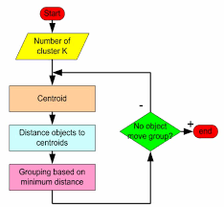
Clustering Model
This study use the K-Means Clustering model to group customers adopt by (Bapna et al., 2004)
01
Determine the number of clusters with elbow method
02
Each data point in the data set will be assigned to the nearest centroid, and then a new centroid is generated.
03
To recalculate a new cluster by assigning all data points to the nearest centroid, and then a new group is created.
04
The process will be repeated between step 2 and step 3 until the stopping criteria are met.
03 | Methodology

Slide 17



Marketing Strategy Definition
Customer Lifetime Value
Analytical Hierarchy Process
CRM Concept
The step from AHP is described below (Al & Al-Harbi, n.d.; Parvaneh et al., n.d.):
Comparing variables based on cluster results
Make a set of pairwise comparison matrices for each lower level with one matrix for each element
The results of the matrix are required for assessment in each pairwise comparison
Hierarchical synthesis is now used to determine the criterion weights taken from all eigenvectors.
After making all pairwise comparisons, consistency is determined using the eigenvalues with formula
$$CI=\frac{λ\max{−n}}{n−1}$$
Where:
CI = Consistency index
$λ maximum$ = the eigenvalue of the predetermined variable value
$$n=number of criteria$$
Steps 3 to 5 are performed for all levels in the hierarchy.
Based on the results of CLV, then we can determine the targeting that aims to develop customer service improvement strategies based on the concept of customer relationship CRM (S. M. S. Hosseini et al., 2010)
CLV is calculated based on the CLV rating determined for each segment (Khajvand et al., 2011). CLV equation calculation is as follow:
$$CLV=X_{i}{∗W}_{j}+…+X_{n}{∗W}_{n}$$
where:
X = variables values from cluster results
N = end of the variable and weight based on the number of clustered variables
W = weight of each value of cluster result
I = start of the variable
J = start of the weight
Customer Type | Sustainable Marketing | One To One Marketing
Profitable Customer | Business To Business | Customer Business Development
Less Profitable Customer | Continuous Replenishment Program | Retail Account Marketing
03 | Methodology

Slide 18
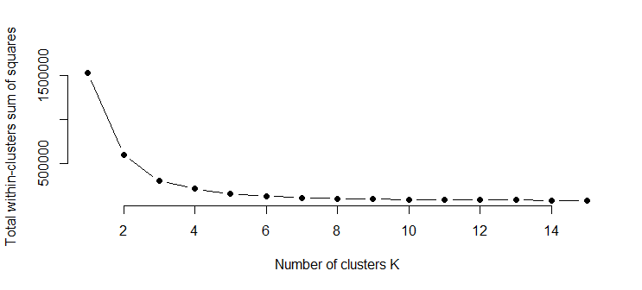
Result
Result Of Clustering
01
Find Correct Variable
02
Determined The Number of Cluster
P | FT | TK | NPL | PL | NPLF | PLF | TC | D | DIM1 | DIM2 | TV
√ | √ | × | √ | √ | × | × | × | × | 69.2% | 25.1 % | 94.3 %
√ | √ | × | √ | √ | √ | √ | √ | × | 79.7 % | 14.3 % | 94.0 %
√ | √ | × | √ | √ | √ | √ | × | v | 65.7 % | 14.4 % | 80.1 %
√ | √ | × | √ | √ | √ | √ | √ | √ | 69.7 % | 12.6 % | 82.3 %
√ | √ | √ | × | × | × | × | × | √ | 47.3 % | 25.1 % | 72.4 %
√ | √ | √ | × | × | × | × | √ | √ | 57.1 % | 20.1 % | 77.2 %
√ | √ | √ | × | × | × | × | √ | × | 71.4 % | 25.1 % | 96.5 %
√ | × | × | √ | √ | √ | √ | × | × | 92.5 % | 5.1 % | 97.5 %
√ | × | × | √ | √ | × | × | × | × | 91.9 % | 5.8 % | 97.7 %
√ | √ | × | √ | √ | × | × | √ | × | 93.2% | 4.4 % | 97.6 %
Description: P: Power, FT: Flash Time, TC: Total KWH, NPL: Non Peak Load, PL: Peak Load, NPLF: Non Peak Load Fee, PLF: Peak Load Fee, TC: Total Cost, D: Discount, DIM1: Dimension1, DIM2:Dimension2, TV: Total Variant
04 | Result & Analysis
03 | Methodology

Slide 19
Marketing Strategy Definition
Result
Customer Lifetime Value
Analytical Hierarchy Process
CRM Concept
The step from AHP is described below (Al & Al-Harbi, n.d.; Parvaneh et al., n.d.):
Comparing variables based on cluster results
Make a set of pairwise comparison matrices for each lower level with one matrix for each element
The results of the matrix are required for assessment in each pairwise comparison
Hierarchical synthesis is now used to determine the criterion weights taken from all eigenvectors.
After making all pairwise comparisons, consistency is determined using the eigenvalues with formula
$$CI=\frac{λ\max{−n}}{n−1}$$
Where:
CI = Consistency index
$λ maximum$ = the eigenvalue of the predetermined variable value
$$n=number of criteria$$
Steps 3 to 5 are performed for all levels in the hierarchy.
Based on the results of CLV, then we can determine the targeting that aims to develop customer service improvement strategies based on the concept of customer relationship CRM (S. M. S. Hosseini et al., 2010)
CLV is calculated based on the CLV rating determined for each segment (Khajvand et al., 2011). CLV equation calculation is as follow:
$$CLV=X_{i}{∗W}_{j}+…+X_{n}{∗W}_{n}$$
where:
X = variables values from cluster results
N = end of the variable and weight based on the number of clustered variables
W = weight of each value of cluster result
I = start of the variable
J = start of the weight
Customer Type | Sustainable Marketing | One To One Marketing
Profitable Customer | Business To Business | Customer Business Development
Less Profitable Customer | Continuous Replenishment Program | Retail Account Marketing
04 | Result & Analysis
03 | Methodology

Slide 20
Marketing Strategy Definition
Result
Customer Lifetime Value
Analytical Hierarchy Process
CRM Concept
The step from AHP is described below (Al & Al-Harbi, n.d.; Parvaneh et al., n.d.):
Comparing variables based on cluster results
Make a set of pairwise comparison matrices for each lower level with one matrix for each element
The results of the matrix are required for assessment in each pairwise comparison
Hierarchical synthesis is now used to determine the criterion weights taken from all eigenvectors.
After making all pairwise comparisons, consistency is determined using the eigenvalues with formula
$$CI=\frac{λ\max{−n}}{n−1}$$
Where:
CI = Consistency index
$λ maximum$ = the eigenvalue of the predetermined variable value
$$n=number of criteria$$
Steps 3 to 5 are performed for all levels in the hierarchy.
Based on the results of CLV, then we can determine the targeting that aims to develop customer service improvement strategies based on the concept of customer relationship CRM (S. M. S. Hosseini et al., 2010)
CLV is calculated based on the CLV rating determined for each segment (Khajvand et al., 2011). CLV equation calculation is as follow:
$$CLV=X_{i}{∗W}_{j}+…+X_{n}{∗W}_{n}$$
where:
X = variables values from cluster results
N = end of the variable and weight based on the number of clustered variables
W = weight of each value of cluster result
I = start of the variable
J = start of the weight
Customer Type | Sustainable Marketing | One To One Marketing
Profitable Customer | Business To Business | Customer Business Development
Less Profitable Customer | Continuous Replenishment Program | Retail Account Marketing
04 | Result & Analysis
03 | Methodology

Slide 21
Marketing Strategy Definition
Result
Customer Lifetime Value
Analytical Hierarchy Process
CRM Concept
The step from AHP is described below (Al & Al-Harbi, n.d.; Parvaneh et al., n.d.):
Comparing variables based on cluster results
Make a set of pairwise comparison matrices for each lower level with one matrix for each element
The results of the matrix are required for assessment in each pairwise comparison
Hierarchical synthesis is now used to determine the criterion weights taken from all eigenvectors.
After making all pairwise comparisons, consistency is determined using the eigenvalues with formula
$$CI=\frac{λ\max{−n}}{n−1}$$
Where:
CI = Consistency index
$λ maximum$ = the eigenvalue of the predetermined variable value
$$n=number of criteria$$
Steps 3 to 5 are performed for all levels in the hierarchy.
Based on the results of CLV, then we can determine the targeting that aims to develop customer service improvement strategies based on the concept of customer relationship CRM (S. M. S. Hosseini et al., 2010)
CLV is calculated based on the CLV rating determined for each segment (Khajvand et al., 2011). CLV equation calculation is as follow:
$$CLV=X_{i}{∗W}_{j}+…+X_{n}{∗W}_{n}$$
where:
X = variables values from cluster results
N = end of the variable and weight based on the number of clustered variables
W = weight of each value of cluster result
I = start of the variable
J = start of the weight
Customer Type | Sustainable Marketing | One To One Marketing
Profitable Customer | Business To Business | Customer Business Development
Less Profitable Customer | Continuous Replenishment Program | Retail Account Marketing
04 | Result & Analysis
03 | Methodology

